Slide 1


Master Thesis Research
Real-Time Object Detection of Personal Protective Equipment in Video Streams Using Deep Learning Techniques
Thesis_AI900_T3_MSIAI_Second Trimester 2024
Prof. Yasser Abdelhamid
Younis Arrabi & Mohammad Al Johani

Slide 2
Agenda
1
Introduction
4
Objective
7
Conclusion and Future Work
PPE importance, challenges, Technologies in Object detection
Create a model that caters to the requirements, for detecting PPE in AI systems and offer an explanation of performance indicators (KPIs) metrics.
Effectiveness of the Model, & Future work.
2
Problem Definition
5
Methodology
8
Questions
Describe the dataset, and Model Implementation and Evaluation
Q&A Opened space
Address current problem, and motivation to solve those limitations using AI.
Previous Work
Results and Discussion
3
6
List previous techniques and advances ones, and provide high level comparison.
Present Performance KPIs, showing Visual examples & Model performance main KPIs

Slide 3

Agenda
Introduction
4
Objective
7
Conclusion and Future Work
PPE importance, challenges, Technologies in Object detection
Create a model that caters to the requirements, for detecting PPE in AI systems and offer an explanation of performance indicators (KPIs) metrics.
Effectiveness of the Model, & Future work.
2
Problem Definition
5
Methodology
8
Questions
Describe the dataset, and Model Implementation and Evaluation
Q&A Opened space
Address current problem, and motivation to solve those limitations using AI.
Previous Work
Results and Discussion
3
6
List previous techniques and advances ones, and provide high level comparison.
Present Performance KPIs, showing Visual examples & Model performance main KPIs

Slide 4



Introduction
Importance of Personal Protective Equipment
Overview of Personal Protective Equipment (PPE) in ensuring workplace safety
Need for Automation
Challenges in traditional PPE monitoring methods
Advances in Technology
Introduction to deep learning and its role in enhancing PPE compliance

Slide 5



Introduction
Importance of Personal Protective Equipment (PPE)
Overview of Personal Protective Equipment (PPE) in ensuring workplace safety
Workers Safety
Worker adherence to safety rules within workplace is a challenges that addressed in last decades, as countries are expanding the projects and workers safety becomes critical requirements
Companies Needs
Companies looking to have high safe environment for the workers as this have high impact on company values, like reputation, finance impact on workers accidents, violation registered on government affairs.
Government Regularity Affairs
The impact is multifaceted, influencing regulatory oversight, public health, economic policies, and legal frameworks. Governments are tasked with setting and enforcing PPE standards to ensure workplace safety, which reduces accidents and fatalities.
Using Personal Protective equipment, and there is multiple types of them, Helmet, googles, Earplug, Masks, Gloves, safety shoes, and more
Safety Protocols training, and companies special Safety arrangements and certificates

Slide 6


Introduction
Need for Automation
Challenges in traditional PPE monitoring methods
PPE Usage Manual Detection
Inspectors need to check PPE compliance which is slow and prone to mistakes leading to delayed safety breach detection and higher accident risks from oversights resulting in costly labor expenses Moreover manual checks are less efficient, in large, dynamic environments where constant monitoring is required.
PPE Usage Auto Detection
Automatic detection of PPE uses advanced technologies like sensor based, and computer vision and deep learning to monitor compliance in real-time, ensuring consistent and accurate safety checks. It reduces human error, provides immediate feedback, and enhances efficiency by covering large and complex environments effortlessly.

Slide 7
Introduction
Advances in Technology
Introduction to deep learning and its role in enhancing PPE compliance
Sensor Based PPE Detection
Using sensor technology for detecting PPE involves utilizing tools such as RFID tags and GPS to track the presence and proper utilization of equipment in real time within safety procedures already in place to ensure adherence to safety measures. Nonetheless these systems can be expensive to install and maintain may face challenges with interference and might not be suitable, for all settings.
Deep Learning PPE Detection
Utilizing Deep learning improves the automated identification of PPE by using neural networks to precisely recognize and categorize safety gear instantly in different settings, with increased precision and flexibility while minimizing human involvement and errors risk but it demands significant computational power and extensive training data for optimal performance.

Slide 8
Agenda
Introduction
4
Objective
7
Conclusion and Future Work
1
PPE importance, challenges, Technologies in Object detection
Create a model that caters to the requirements, for detecting PPE in AI systems and offer an explanation of performance indicators (KPIs) metrics.
Effectiveness of the Model, & Future work.
Problem Definition
5
Methodology
8
Questions
Address current problem, and motivation to solve those limitations using AI.
Describe the dataset, and Model Implementation and Evaluation
Q&A Opened space
Previous Work
Results and Discussion
3
6
List previous techniques and advances ones, and provide high level comparison.
Present Performance KPIs, showing Visual examples & Model performance main KPIs

Slide 9


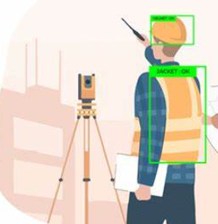
Problem Definition
Advances in Technology
Identify the problem and what uses to overcome the problem in PPE Detection
Problem
The reliance on manual PPE inspections and periodic audits is insufficient in dynamic industrial environments, leading to delayed detection of safety breaches and increased risk of accidents. This gap necessitates the development of real-time automated systems to enhance safety compliance, reduce accidents, and improve overall workplace safety.
Solution
Utilizing Deep learning improves the automated identification of PPE by using neural networks to precisely recognize and categorize safety gear instantly in different settings, with increased precision and flexibility while minimizing human involvement and errors risk but it demands significant computational power and extensive training data for optimal performance.

Slide 10
Agenda
Introduction
4
Objective
7
Conclusion and Future Work
1
PPE importance, challenges, Technologies in Object detection
Create a model that caters to the requirements, for detecting PPE in AI systems and offer an explanation of performance indicators (KPIs) metrics.
Effectiveness of the Model, & Future work.
Problem Definition
5
Methodology
8
Questions
2
Address current problem, and motivation to solve those limitations using AI.
Describe the dataset, and Model Implementation and Evaluation
Q&A Opened space
Previous Work
Results and Discussion
6
List previous techniques and advances ones, and provide high level comparison.
Present Performance KPIs, showing Visual examples & Model performance main KPIs

Slide 11

Previous Work
Previous Work
List previous techniques and advances ones, and provide high level comparison.
MANUAL DETECTION
AUTO PPE DETECTION
COMPUTER VISION PPE DETECTION
SENSOR BASED PPE DETECTION
State-Of-The-Art

Slide 12
Previous Work
Previous Work
List previous techniques and advances ones, and provide high level comparison.
Devices
Advantage
Disadvantage
Application
Sensor Based
PPE Detection
RFID
GPS Tracker
Bluetooth
Proximity Sensors
Pressure Sensors
RFID TAG per PPE equipment, Antennas, RFID Readers, Databases
real-time monitoring
Integration with other monitoring system
High Cost, Sensors is sensitive to Metal environment subject to interference
used at the site entrance & exits
GPS Devise Per PPE equipment, Database.
effective in large, open environments and can provide detailed location data over extensive areas
Used in Outdoor
High Operation Cost
mining operations, GPS installed in PPE
Bluetooth sensors per PPE
Detectors
Low Cost
Indoor Environment
Limited in Range
Subject to interference
used in manufacturing plants
Proximity sensors, TAGs per PPE
Real-time
High operation cost
chemical plants
Pressure-sensitive mats or floors detect the presence
Real-time
High Operation cost
Laboratories

Slide 13
Previous Work
Previous Work
Previous work USING YOLO Algorithm
Year | Goal | Algorithm | Dataset | Performance Measure
2018 | Monitor PPE in nuclear facilities (Hard Hats, Full-face Masks) | YOLOv3 (two-phase training) | 3,808 images (Real-world via webcam and web crawling) | Precision: 97.64%, Recall: 93.11%, FPS: 7.96
2019 | Real-time PPE detection on construction sites | YOLOv3 with data augmentation | ~2,500 images (Manually collected and web scraping) | mAP: 97%, Recall: 97%, F1-Score: 97%
2020 | Enhance worker safety through real-time detection | YOLOv3, YOLOv4, YOLOv5 | 1,330 images (CHV dataset with 6 classes) | YOLOv5x mAP: 86.55%, YOLOv5s FPS: 52
2021 | Detect helmets and heads in real-time | YOLOv5x with Power-law transformation | 3,000 training, 1,000 testing (MakeML public dataset) | Accuracy: 92%, Precision: 92.4%, Recall: 89.2%, F1-Score: 90.8%
2022 | Hybrid detection of PPE on construction sites | YOLOv4, YOLOv4-Tiny with CLSlim pruning | ~25,000 samples (Security footage of construction site) | mAP loss: 2.1%, Inference speed: 1.8x, Compression: 98.2%
2022 | Detect PPE in hazardous industrial areas using video streams | YOLOv4-Tiny, SSD MobileNet, CenterNet, EfficientDet | 7,035 images (Public dataset), 215 & 236 images (Controlled) | YOLOv4-tiny mAP: 86%
2022 | Real-time PPE monitoring using CCTV cameras | YOLOv4 with cognitive safety analysis | CCTV footage (Number not specified) | mAP: 80.19%, FPS: 80
2022 | Improve helmet detection using one-stage object detector | YOLOv5 with ShuffleNetv2, MobileNetv3 backbones | 7,041 images (Roboflow's "Hard Hat" dataset) | Precision: 94.2%, Recall: 91%
2022 | Enhance safety at construction sites | YOLOv5 (multiple sizes: nano to extra-large) | 7,063 images (Northeastern University, Harvard Dataverse) | mAP50: 95.8%, Precision: 93.9%, Recall: 91.2%, F1-Score: 92.5%
2022 | Develop real-time PPE compliance detection models | YOLOv3, YOLOv4, YOLOv7 | 11,000 images | mAP: 97.29%, FPS: 25.02
2023 | Computer vision-based PPE monitoring platform | YOLACT, DeepSORT for object tracking | 1,288 images (Google Images, surveillance cameras, smartphones) | mAP50: 66.4, DeepSORT accuracy: 91.3%
2023 | Develop robust PPE detection in challenging conditions | YOLOX-m with environmental augmentations | 1,699 images (CHVG dataset) | mAP: 89.84%
2023 | Real-time monitoring system for PPE compliance | YOLOv5 | 18,767 images (FUZ-PPE dataset) | mAP: 84.2%, FPS: 105
2023 | Real-time detection of safety hardhats | Feature extraction, template matching, cascade classification | 239 images (Construction sites) | Most effective: Cascade classifier, Real-time detection
2023 | Detect PPE on offshore drilling platforms | RFA-YOLO with residual feature augmentation | 10,000 images (ODPD), 6,600 samples (FCD), 2,000 images (PPED) | Accuracy: 93.1%, FPS: 13
2023 | Real-time detection of hardhats in hazardous environments | SSD-MobileNet | 3,261 images (Construction surveillance and web crawlers) | Precision: 95%, Recall: 77%
2023 | Real-time PPE detection in industrial sites | YOLOv2 | 731 helmet images (ImageNet) | Effective real-time monitoring, Highlights potential for improving workplace safety

Slide 14
Previous Work
Previous Work
Previous work USING CNN Algorithm
Year | Goal | Algorithm | Dataset | Performance Measure
2022 | Ensure PPE compliance and prevent head injuries | YOLO-based detectors, CNN, Decision Trees | 1,500 annotated images, 4,700 instances (Pictor-v3) | mAP: 72.3%, FPS: 11
2022 | Detection of head-mounted protection gear | YOLOv5, MobileNetv2 SSD, Faster R-CNN | 12,682 images (University of Belgrade, Roboflow, Pictor PPE) | Precision: 92%, Recall: 61.1%, Hardhats Precision: 100%, Recall: 96%
2023 | Ensure worker safety by detecting PPE | R-CNN architecture | 1,129 images (MIT database), 333 additional images | Accuracy: 70%
2023 | Facial recognition and PPE detection for restricted access | Faster R-CNN with data augmentation | Kaggle dataset | mAP: 99% at 3m, 89% at 5m
2023 | PPE compliance using position-guided anchoring | Position-guided anchoring, CNN-based classifiers | 932 images (CPPE dataset) | F-score: 97% (hardhats), 95% (vests)
2023 | Enhance construction safety via worker tracking and hazard prediction | R-CNN and CNN-based models | Surveillance video frames (Construction sites) | mAP: 92%, AP: 95%, Safety position precision: 87%
2023 | Detect hardhat violations and issue alarms | CNN with MobileNet backbone, residual blocks | Custom dataset (Construction workers with/without hardhats) | AP: 87% (negative), 89% (positive), FPS: 62

Slide 15
Previous Work
Previous Work
Conclusion
Accuracy
Inference Time
Model Complexity
Localization Accuracy
Scalability
Training Time
Computer Vision
PPE Detection
CNN-based Detectors
YOLO
Higher accuracy, better for complex scenes
Slower, not suitable for real-time applications
High complexity, requires more resources
Very accurate in localizing objects
Less scalable without significant changes
Longer training times
Competitive accuracy, improving with each version
Fast, designed for real-time detection
Lower complexity, more efficient
Improved localization, but still behind CNN-based models
Highly scalable with minor modifications
Relatively efficient training

Slide 16
Agenda
Introduction
Objective
7
Conclusion and Future Work
1
PPE importance, challenges, Technologies in Object detection
Create a model that caters to the requirements, for detecting PPE in AI systems and offer an explanation of performance indicators (KPIs) metrics.
Effectiveness of the Model, & Future work.
Problem Definition
5
Methodology
8
Questions
2
Address current problem, and motivation to solve those limitations using AI.
Describe the dataset, and Model Implementation and Evaluation
Q&A Opened space
3
Previous Work
Results and Discussion
6
List previous techniques and advances ones, and provide high level comparison.
Present Performance KPIs, showing Visual examples & Model performance main KPIs

Slide 17
Objective
Objective
Develop a real-time object detection model for PPE using YOLO
Sub-Objectives
Select appropriate object detection algorithms.
Evaluate the model’s performance
Evaluate the model’s performance based on accuracy, precision, and recall.

Slide 18
Agenda
Introduction
Objective
7
Conclusion and Future Work
1
4
PPE importance, challenges, Technologies in Object detection
Create a model that caters to the requirements, for detecting PPE in AI systems and offer an explanation of performance indicators (KPIs) metrics.
Effectiveness of the Model, & Future work.
Problem Definition
Methodology
8
Questions
2
Address current problem, and motivation to solve those limitations using AI.
Describe the dataset, and Model Implementation and Evaluation
Q&A Opened space
3
Previous Work
Results and Discussion
6
List previous techniques and advances ones, and provide high level comparison.
Present Performance KPIs, showing Visual examples & Model performance main KPIs

Slide 19
Methodology
Dataset Construction
Describe dataset construction, and
Model Training
Training the YOLOv8 model using the prepared dataset.
Evaluation
Performance assessment using metrics like mAP, precision, recall, & F1 score.

Slide 20






Methodology
Methodology Complete Cycle.
Object Detection Model
Validation
Dataset
Augmentation
Evaluation
Dataset Construction
Model Training & Evaluation
After Evaluation

Slide 21
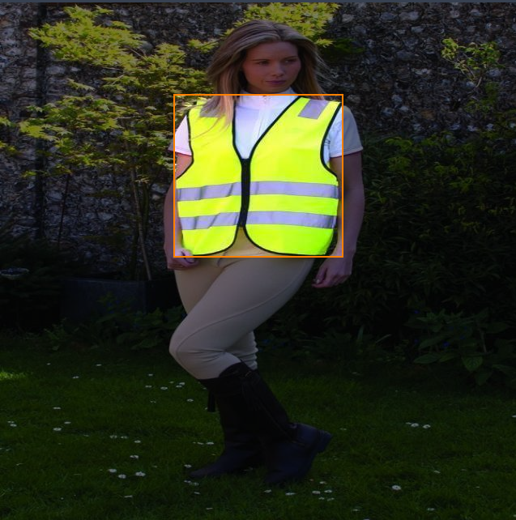
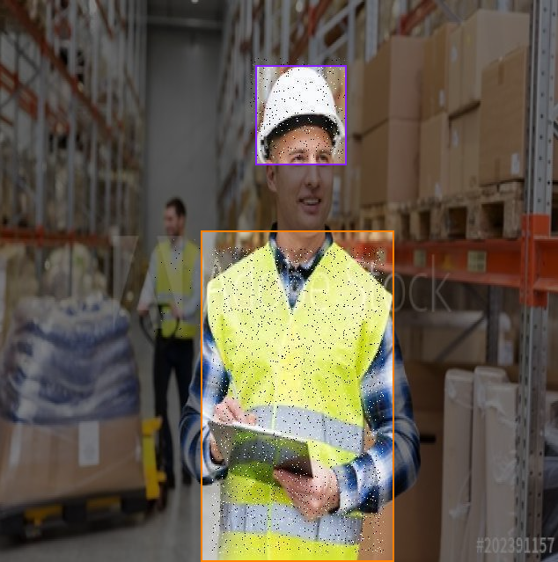

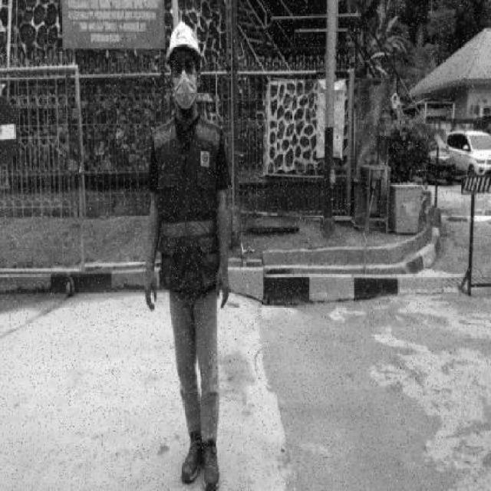
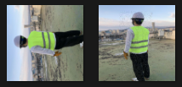
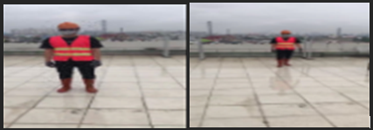
Methodology
Dataset Construction
Develop a real-time object detection model for PPE using YOLO
Collection
images are collected from roboflow website, including real-world environments and publicly available datasets
Annotation
These images are annotated with bounding boxes around PPE items like helmets, vests, gloves, and safety goggle.
Augmentation
Data augmentation techniques such as rotation, scaling, and flipping are applied to enhance the dataset's diversity and improve model robustness.
ANNOTATION
NOISE
GRAY SCALE
FLIPPING
SCALING

Slide 22
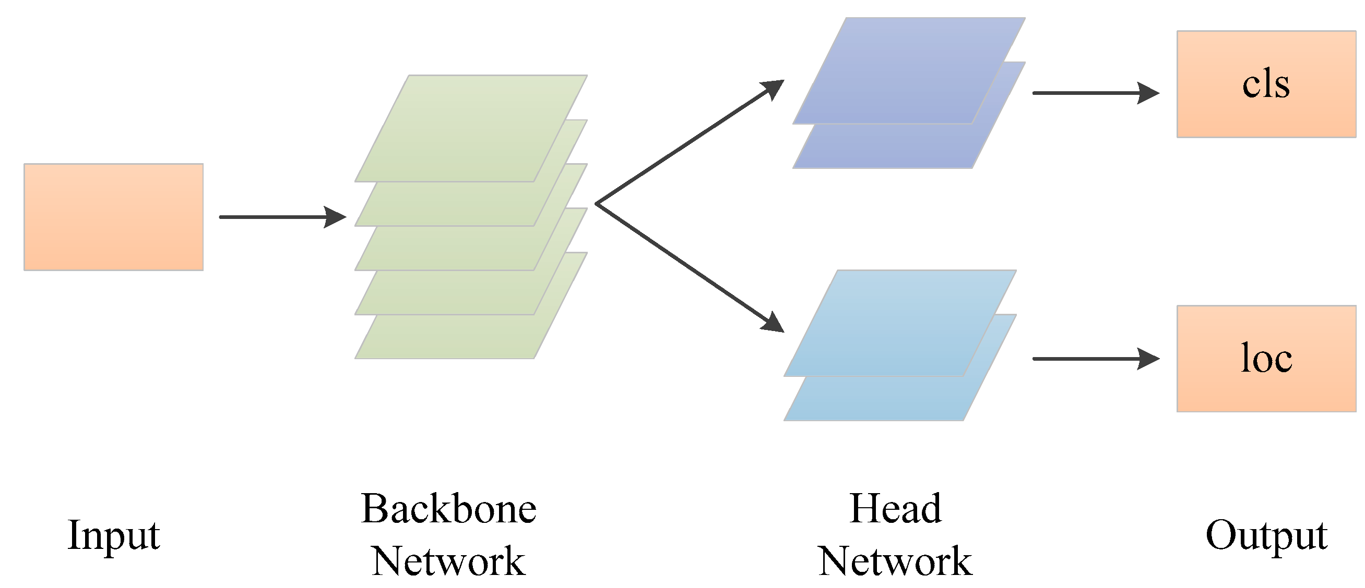
Methodology
YOLOV8 Model
Develop a real-time object detection model for PPE using YOLO
Input and Preprocessing: The image is resized and normalized, preparing it for feature extraction.
Backbone: Extracts features using convolutional layers from the input image, generating feature maps.
Neck: Aggregates features from multiple scales, making the model robust to objects of various sizes, and So, the neck is crucial for refining and improving the features before they are passed on to the head for the final detection tasks.
Head: After the neck, the head of the network takes the refined features and produces the final outputs, including the object class (classification, or "CLS") and the object location (localization, or "LOC").
Object Detection based on detection Stage count
Object Detection
Two Stage
CNN
R-CNN
One Stage
YOLO
Faster R-CNN

Slide 23
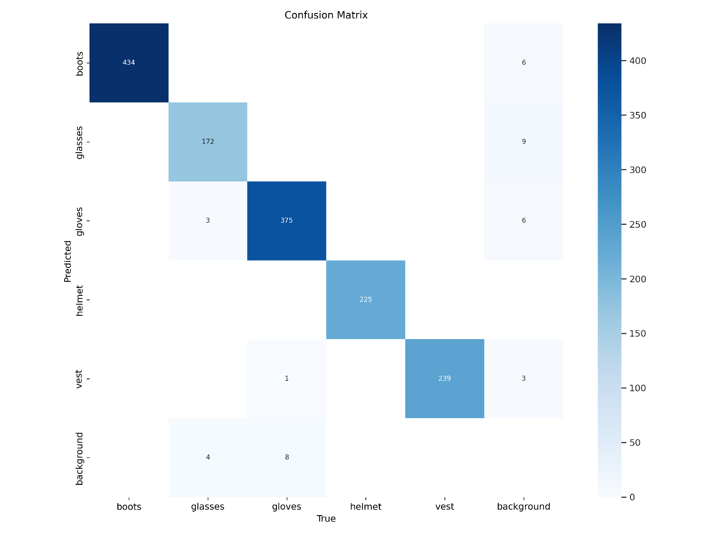
Methodology
Evaluation
Confusion Matrix, it is table layout allows visualization of the performance of an algorithm
Theoretical Confusion Matrix
Model Performance Confusion Matrix

Slide 24
Methodology
Evaluation
Performance assessment using metrics like mAP, precision, recall, & F1 score.
Model Training for PPE Detection: Model training involves feeding the annotated dataset into a deep learning model, YOLOv8, on Google Colab platform using GPU acceleration.
The model learns to detect PPE items by iterating over the data multiple times (epochs) in our case we are using 50 epochs and optimizing its accuracy, precision, and recall.
Below training Model Results
Class | Images | Instances | Recall | mAP50
all | 236 | 1461 | 98.20% | 98.40%
boots | 212 | 434 | 100.00% | 99.50%
glasses | 176 | 179 | 93.70% | 95.90%
gloves | 205 | 384 | 97.10% | 97.70%
helmet | 211 | 225 | 100.00% | 99.50%
vest | 228 | 239 | 100.00% | 99.50%
Class | Images | Instances | F1 Score
all | 236 | 1461 | 98.30%
boots | 212 | 434 | 99.70%
glasses | 176 | 179 | 94.84%
gloves | 205 | 384 | 97.55%
helmet | 211 | 225 | 99.95%
vest | 228 | 239 | 99.35%

Slide 25
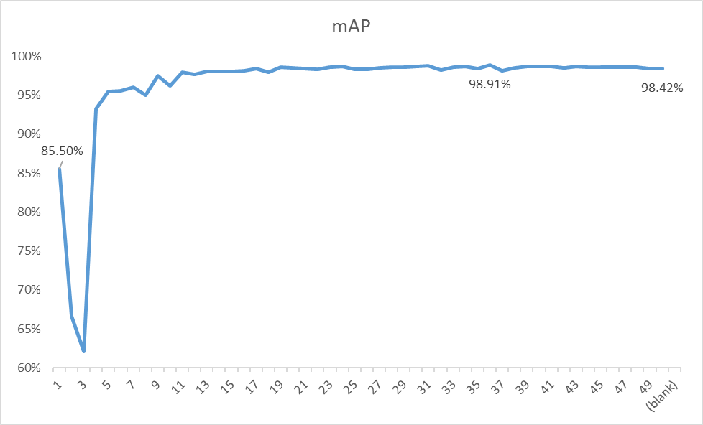
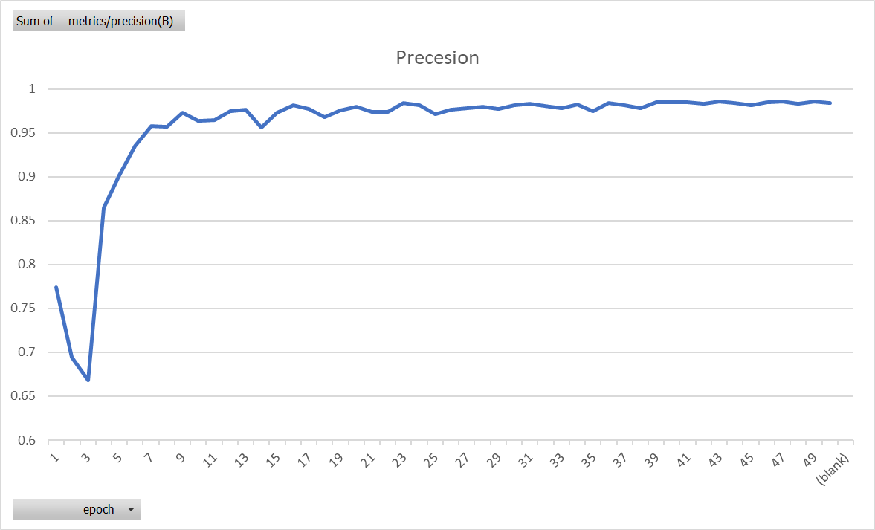
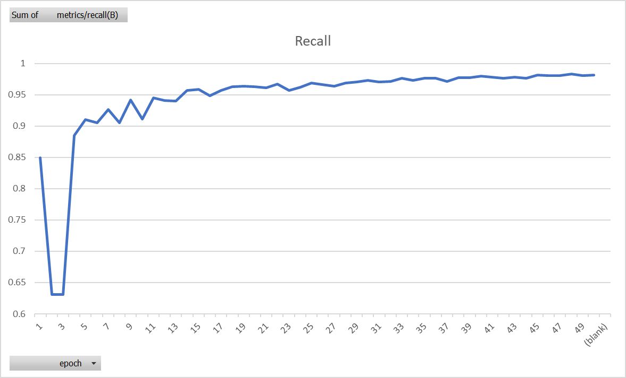
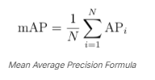
Methodology
Evaluation
Performance assessment using metrics like mAP, precision, recall, & F1 score.
Precision=TP/ (TP+FP)
Recall= TP/ (TP+FN)
F1 score= (2* Precision*Recall)/ (Precision+ Recall)
KPIs Metrics for YOLOv8 Object detection algorithm vs epochs

Slide 26
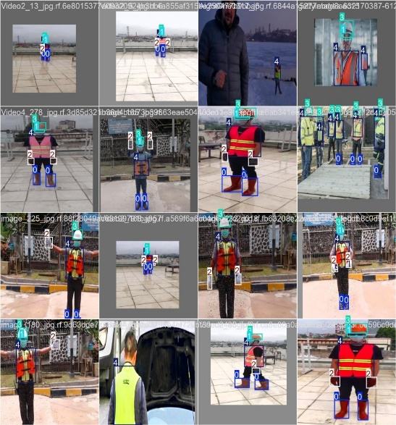
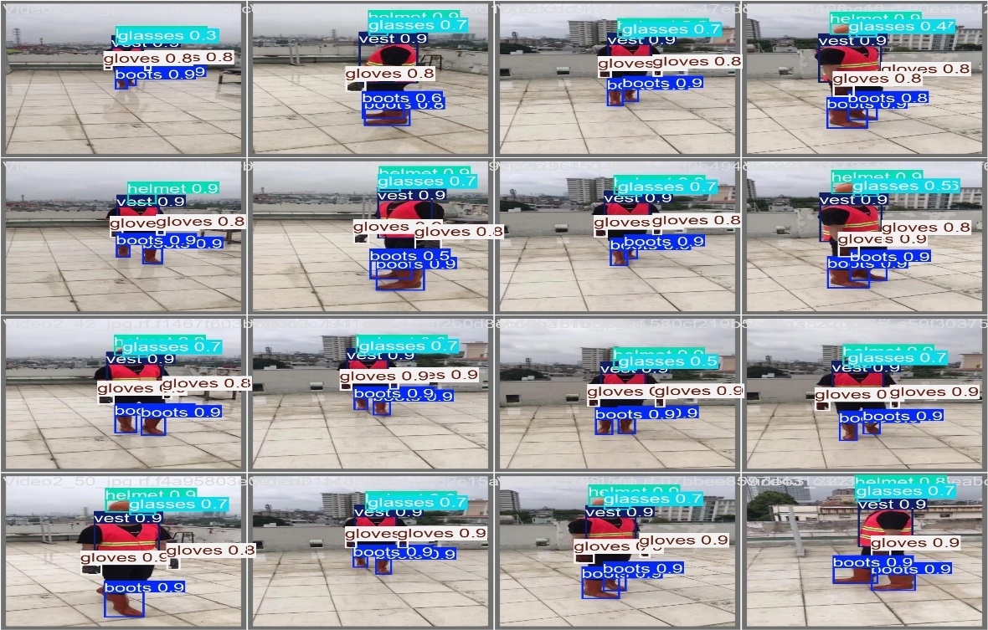
Methodology
Evaluation
Training Batched and Validation Pictures
Validation
Class & Confidence Rate
Training

Slide 27
Agenda
Introduction
Objective
7
Conclusion and Future Work
1
4
PPE importance, challenges, Technologies in Object detection
Create a model that caters to the requirements, for detecting PPE in AI systems and offer an explanation of performance indicators (KPIs) metrics.
Effectiveness of the Model, & Future work.
Problem Definition
5
Methodology
8
Questions
2
Address current problem, and motivation to solve those limitations using AI.
Describe the dataset, and Model Implementation and Evaluation
Q&A Opened space
3
Previous Work
Results and Discussion
List previous techniques and advances ones, and provide high level comparison.
Present Performance KPIs, showing Visual examples & Model performance main KPIs

Slide 28
Results and Discussion
The YOLO version 8 model is showing results in detecting different types of personal protective equipment, During the test, YOLOv8 was applied to a videos stream to detect objects like helmets, safety vests, and other PPE type. The video was processed frame by frame, with YOLOv8 making predictions about the presence and location of these objects in real time.
Confidence Ratio
The confidence ratio, also known as the confidence score, is a measure of how certain the model is about its prediction. It ranges from 0 to 1, where 1 indicates complete confidence in the detection and classification of an object.
High Confidence (close to 1): The model is highly certain that the detected object is correctly classified and the bounding box is accurate.
Low Confidence (closer to 0): The model is less certain about its prediction, which might indicate that the object is partially obscured, in a challenging position, or the image quality is poor.
In practical terms, a threshold is often set (e.g., 0.5 or 0.6) to filter out predictions with low confidence scores, which helps reduce false positives.
In our test we include some of the processed frames, and confidence ratios for each detected class.

Slide 29
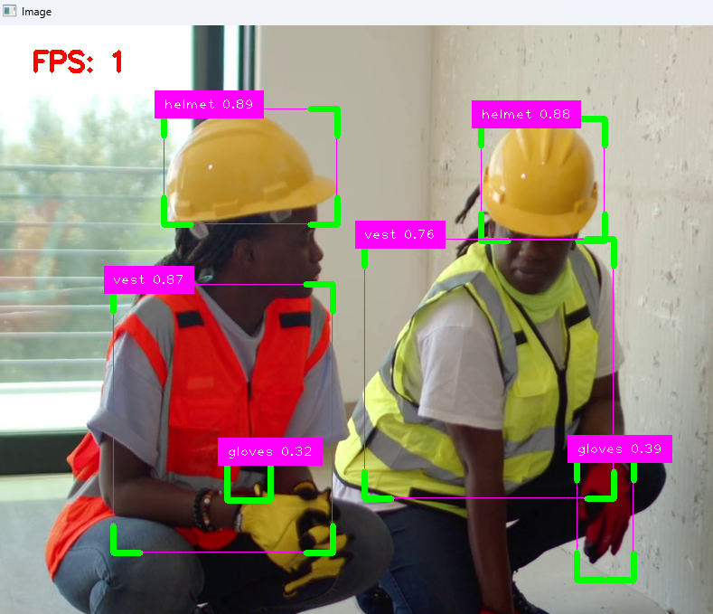
Results and Discussion
Test #1

Slide 30
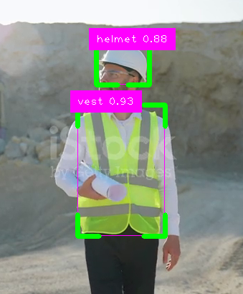
Results and Discussion
Test#2

Slide 31
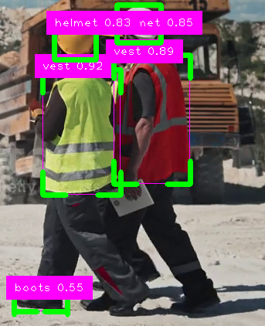
Results and Discussion
Test#3

Slide 32
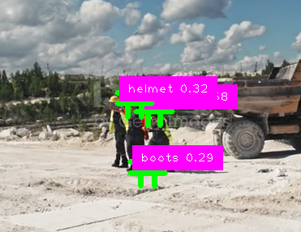
Results and Discussion
Test#4

Slide 33
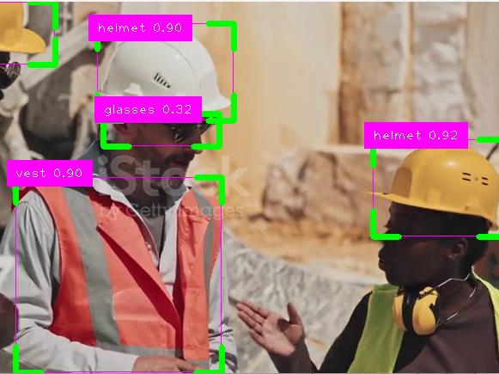
Results and Discussion
Test#5

Slide 34
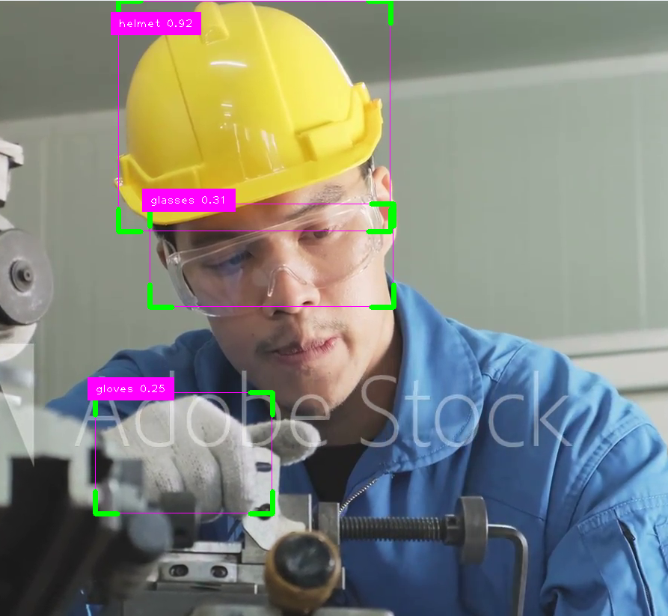
Results and Discussion
Test#6

Slide 35
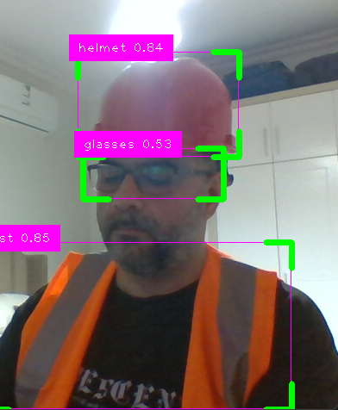
Results and Discussion
Test#7 Live CAM

Slide 36
Agenda
Introduction
Objective
Conclusion and Future Work
1
4
PPE importance, challenges, Technologies in Object detection
Create a model that caters to the requirements, for detecting PPE in AI systems and offer an explanation of performance indicators (KPIs) metrics.
Effectiveness of the Model, & Future work.
Problem Definition
5
Methodology
8
Questions
2
Address current problem, and motivation to solve those limitations using AI.
Describe the dataset, and Model Implementation and Evaluation
Q&A Opened space
3
Previous Work
Results and Discussion
6
List previous techniques and advances ones, and provide high level comparison.
Present Performance KPIs, showing Visual examples & Model performance main KPIs

Slide 37
Conclusion and Future Work
The YOLOv8-based PPE detection system effectively enhances workplace safety with high precision and real-time capabilities, though challenges like processing speed in complex environments persist.
Future work will focus on optimizing the model for various industrial scenarios and improving real-time performance on lower-end hardware.
This research utilized AI and Computer Vision, specifically the YOLOv8 architecture, to enhance workplace safety by ensuring the proper use of Personal Protective Equipment (PPE).
The model effectively addressed the problem of PPE noncompliance by providing real-time detection with an impressive 98.9% mAP accuracy on validation data.
The findings underscore the potential of AI in promoting sustainability, improving employee well-being, and reducing costs for industries.
Further improvements in model performance can be realized by expanding the training datasets, thereby enhancing detection accuracy across diverse scenarios.

Slide 38
Conclusion and Future Work
The future works related to this research can be summarized as follows:
Future research should focus on expanding the dataset to include more varied and complex environments to improve model generalization.
Exploring lightweight versions of the model for deployment on edge devices could enhance its practical application in real-time safety monitoring.
Integrating the model with existing safety management systems and exploring additional deep learning techniques could further refine the system's effectiveness and efficiency in diverse industrial settings.

Slide 39
Agenda
Introduction
Objective
Conclusion and Future Work
1
4
7
PPE importance, challenges, Technologies in Object detection
Create a model that caters to the requirements, for detecting PPE in AI systems and offer an explanation of performance indicators (KPIs) metrics.
Effectiveness of the Model, & Future work.
Problem Definition
5
Methodology
Questions
2
Address current problem, and motivation to solve those limitations using AI.
Describe the dataset, and Model Implementation and Evaluation
Q&A Opened space
3
Previous Work
Results and Discussion
6
List previous techniques and advances ones, and provide high level comparison.
Present Performance KPIs, showing Visual examples & Model performance main KPIs

Slide 40
Questions
Thank You

